Slide 1
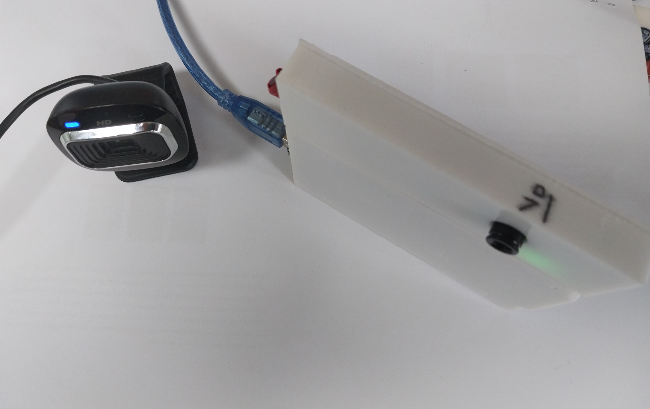
■ Thermal camera

Slide 2
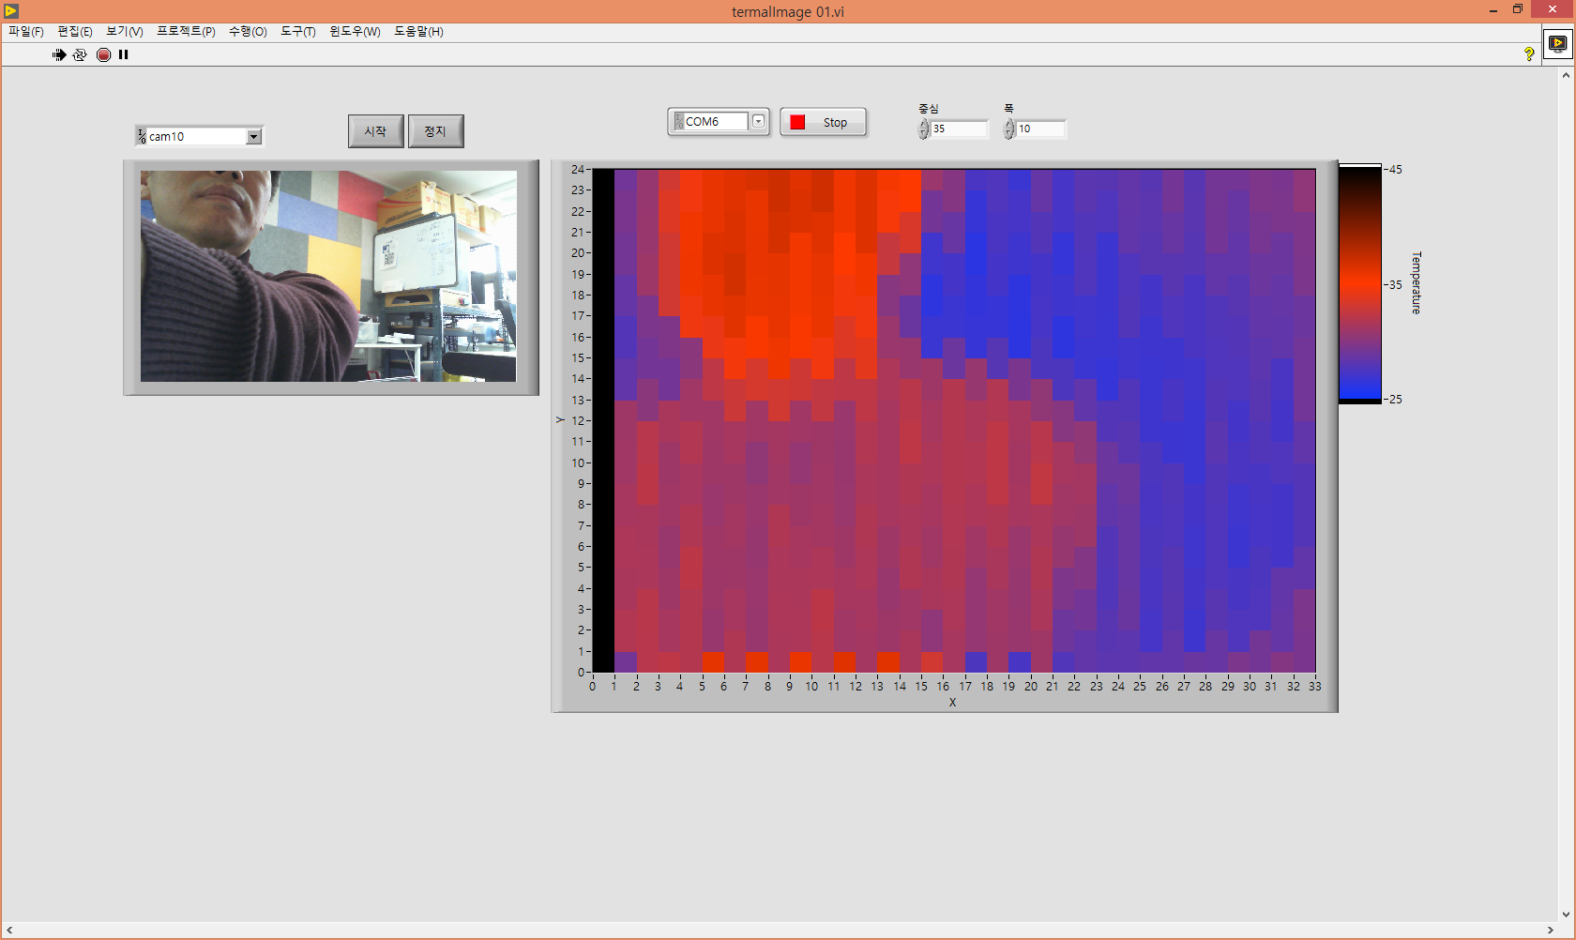
■ MLX90640 Thermal camera and Labview UI

Slide 3
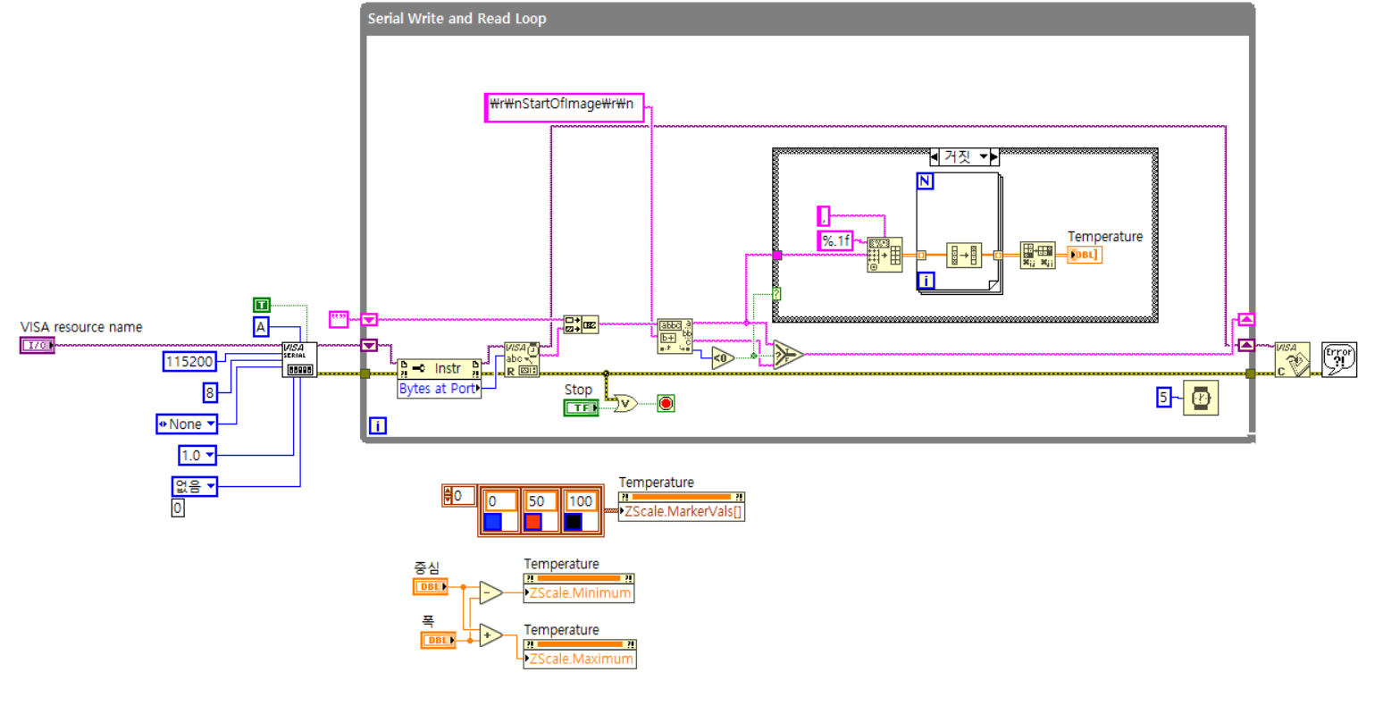
■ MLX90640 Thermal camera and Labview UI

Slide 4
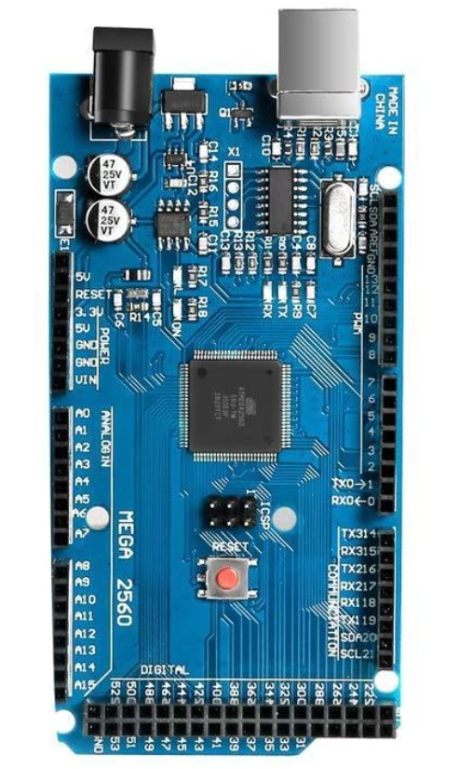
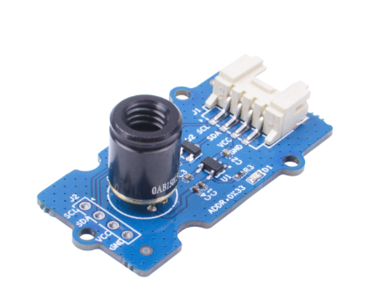
■ Arduino mega 2560 – MLX90640 wiring
MLX-90641 Camera Arduino Mega 2560
SCL - SCL
SDA - SDA
VCC - Vin (3V3)
GND - GND

Slide 5
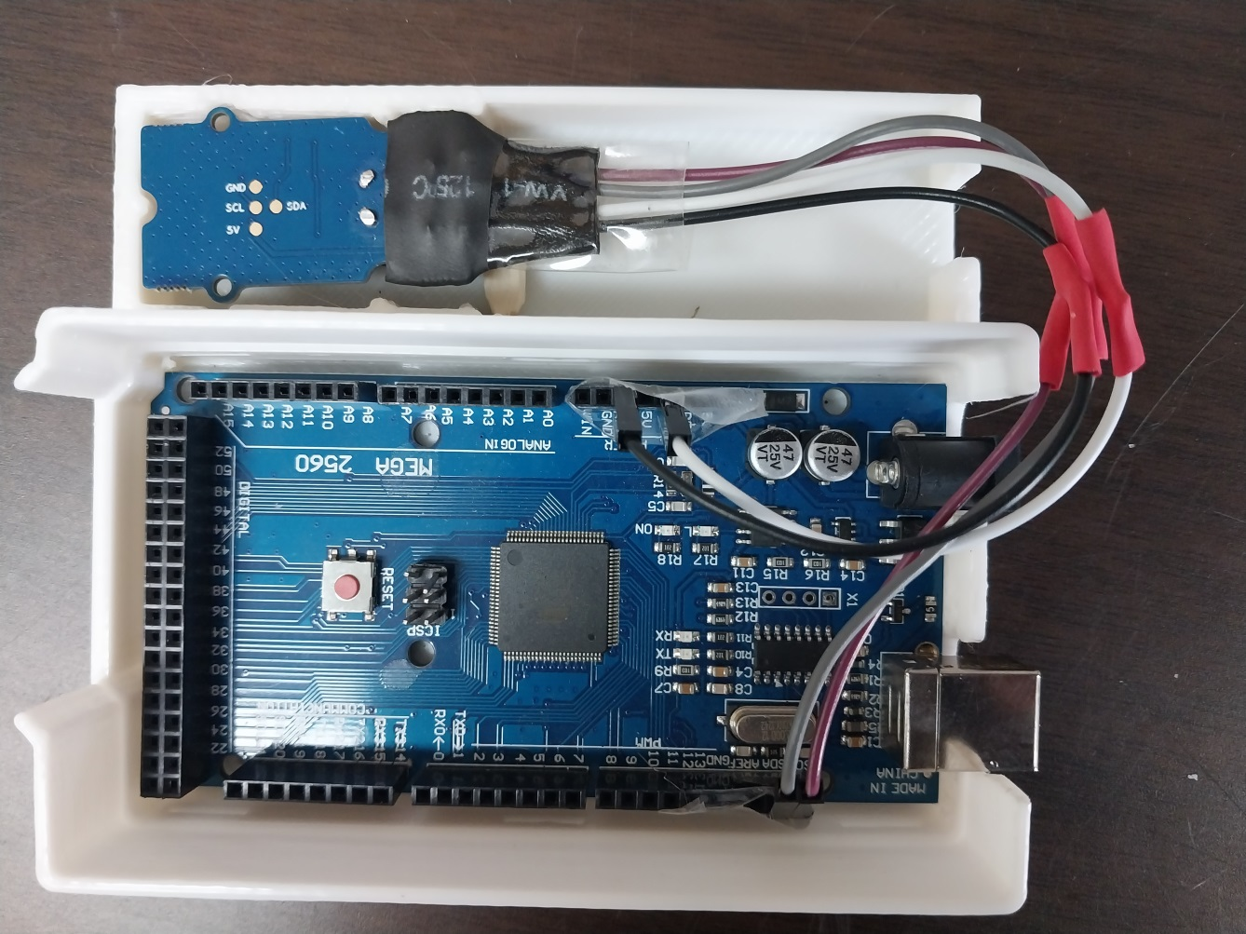
■ Arduino mega 2560 – MLX90640 wiring
MLX-90641 Camera Arduino Mega 2560
SCL - SCL
SDA - SDA
VCC - Vin (3V3)
GND - GND

Slide 6
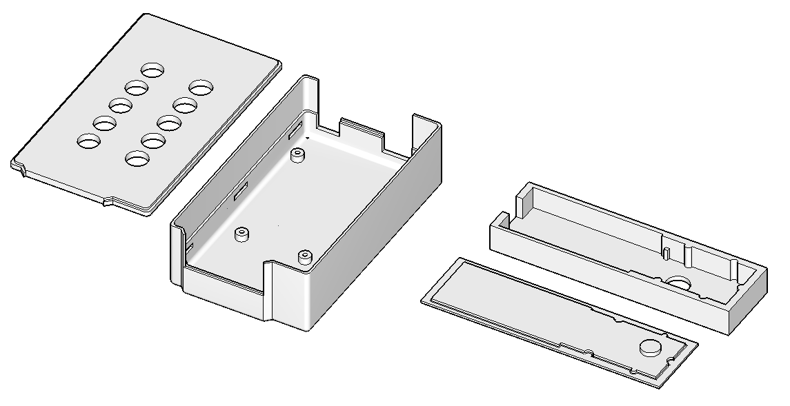
■ Case design

Slide 7
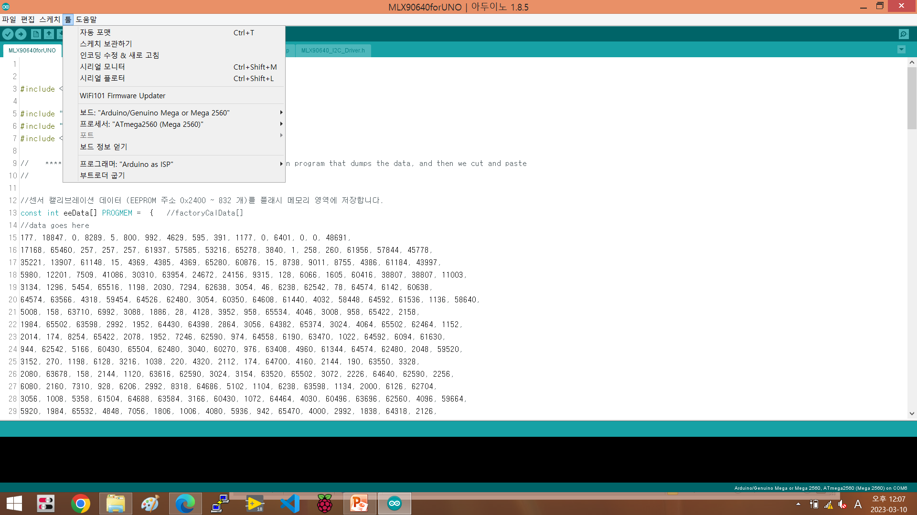
■ Arduino mega 2560 farmware

Slide 8
■ Ref.
https://forums.ni.com/t5/%E5%8C%97%E6%9D%B1%E5%8C%97-LabVIEW%E3%83%A6%E3%83%BC%E3%82%B6%E3%83%BC%E4%BC%9A/LattePanda-Alpha%E3%81%AB32x24%E7%94%BB%E7%B4%A0%E3%81%AE%E8%B5%A4%E5%A4%96%E7%B7%9A%E6%B8%A9%E5%BA%A6%E3%82%BB%E3%83%B3%E3%82%B5-MLX90640%E3%82%92%E6%8E%A5%E7%B6%9A%E3%81%97%E3%81%A6LabVIEW%E3%81%A7%E4%BD%BF%E3%81%A3%E3%81%A6%E3%81%BF%E3%81%9F%E6%84%9F%E6%83%B3/td-p/3931649

